Slide 1

Giraffe
Credit modelling

Slide 2

Table of contents
01
02
03
Motivation
Our product
Our algorithm
04
Highlights

Slide 3
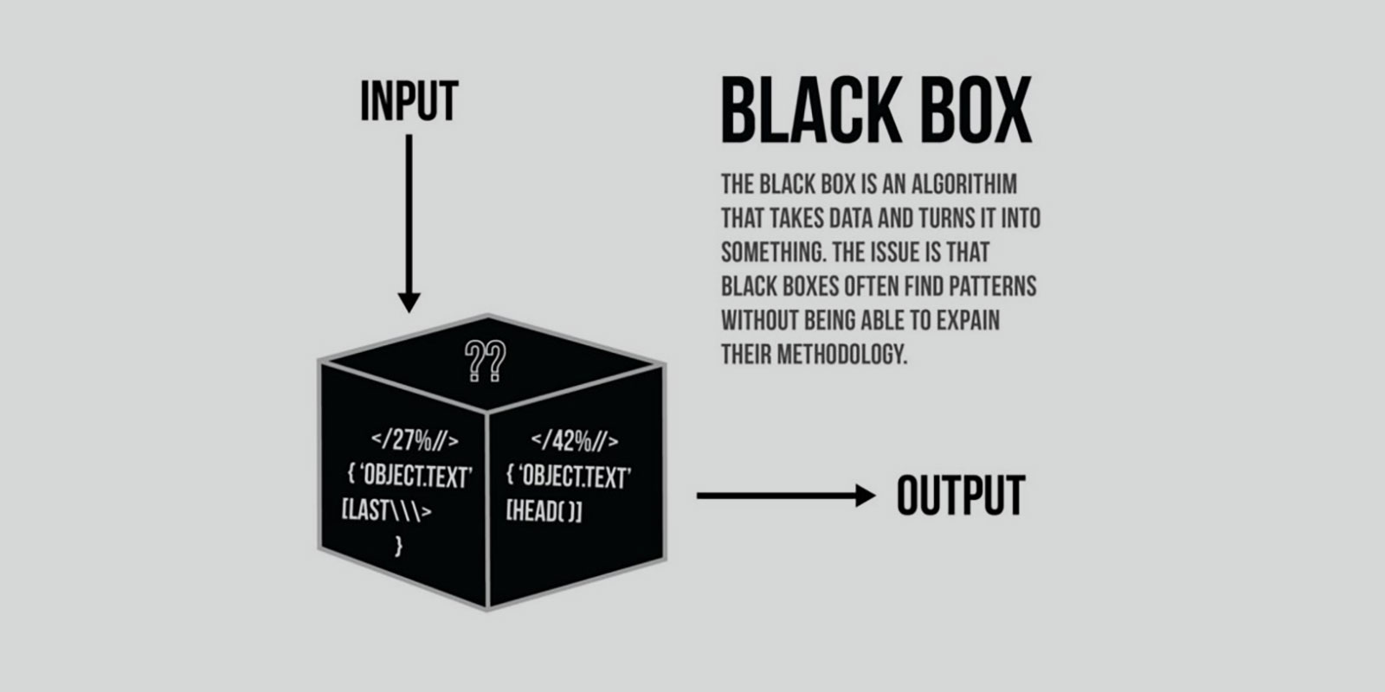


eXplainable AI
Credit Modelling
Explainability
Efficiency
EU: General Data Protection Regulation
US: Equal Credit Opportunity Act
Effectiveness
Notes:
Problem faced by all ai models

Slide 4



Pain Points of Consumer Lending
Back office
Front desk
Applicants
Large scale data;
High-dimensional characteristics;
Time-consuming algorithm;
Model coherency
Model interpretability;
Result reliability;
User interface convenience
Reason of rejection;
Lengthy procedure; Concern of data privacy

Slide 5


What’s Giraffe

Slide 6

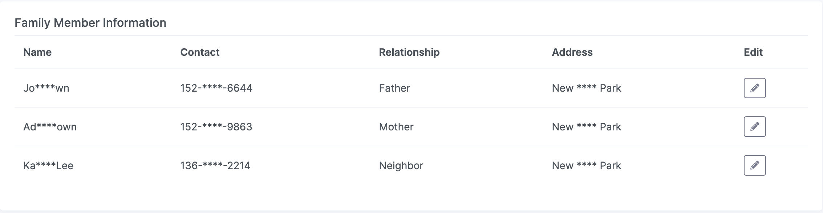
Applicants’ view
Fill in application form
Privacy preserving

Slide 7
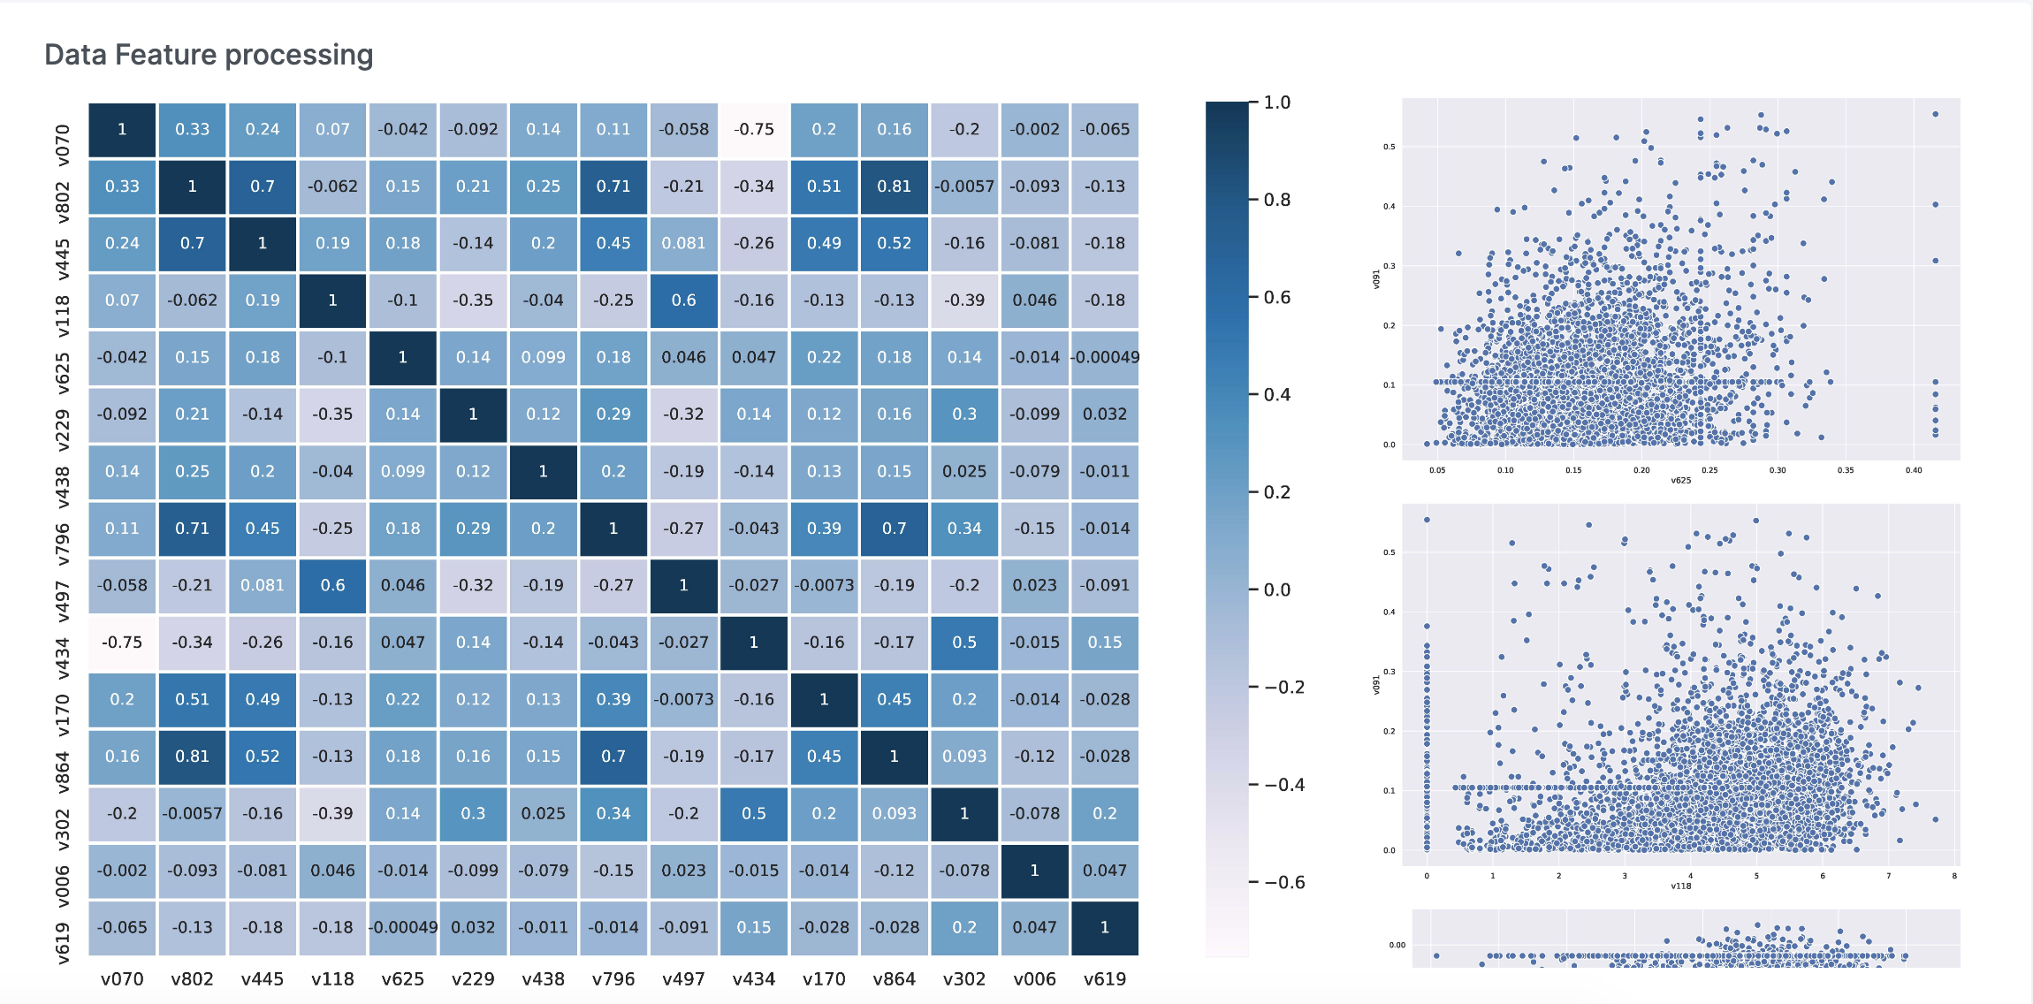
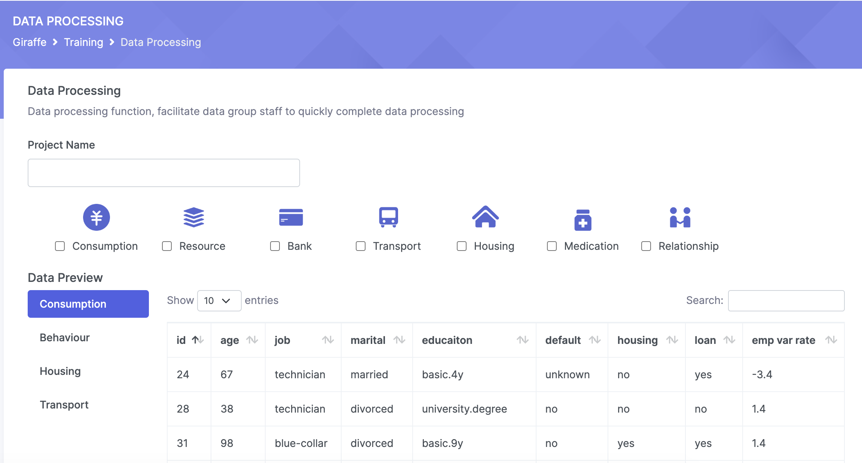
Data analysts’ view
Import external data
Heatmap of feature correlation
Visualisation of summary statistics
Multiple methods for
missing value imputation
Etc…

Slide 8
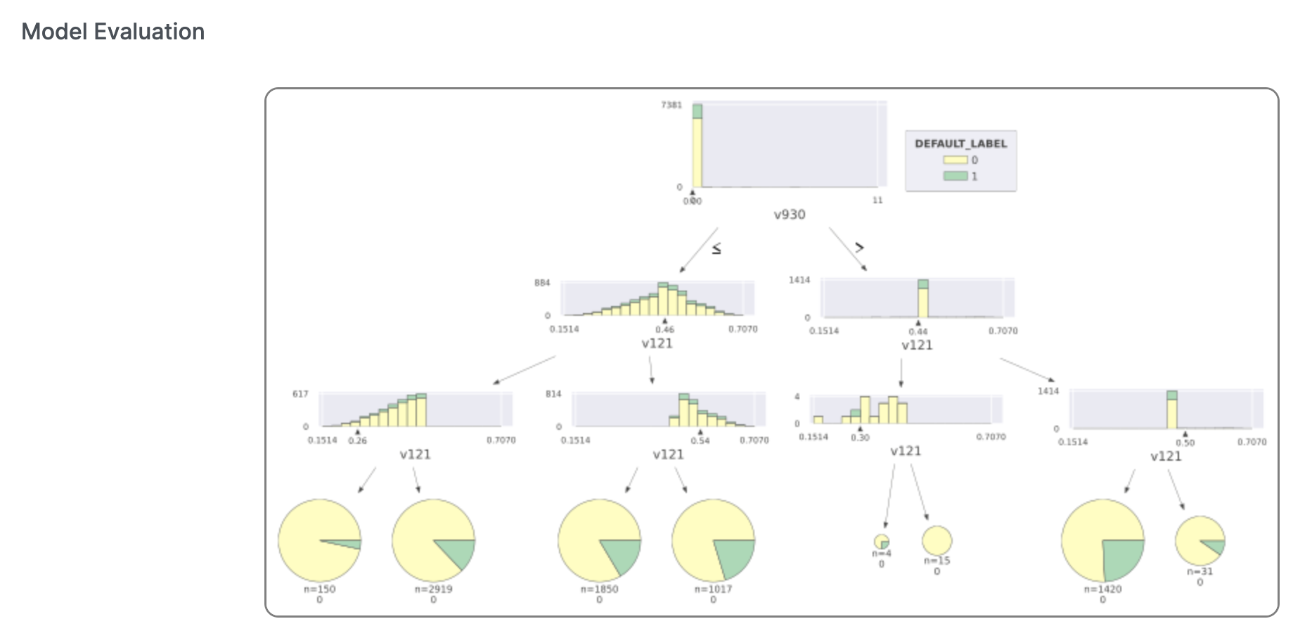
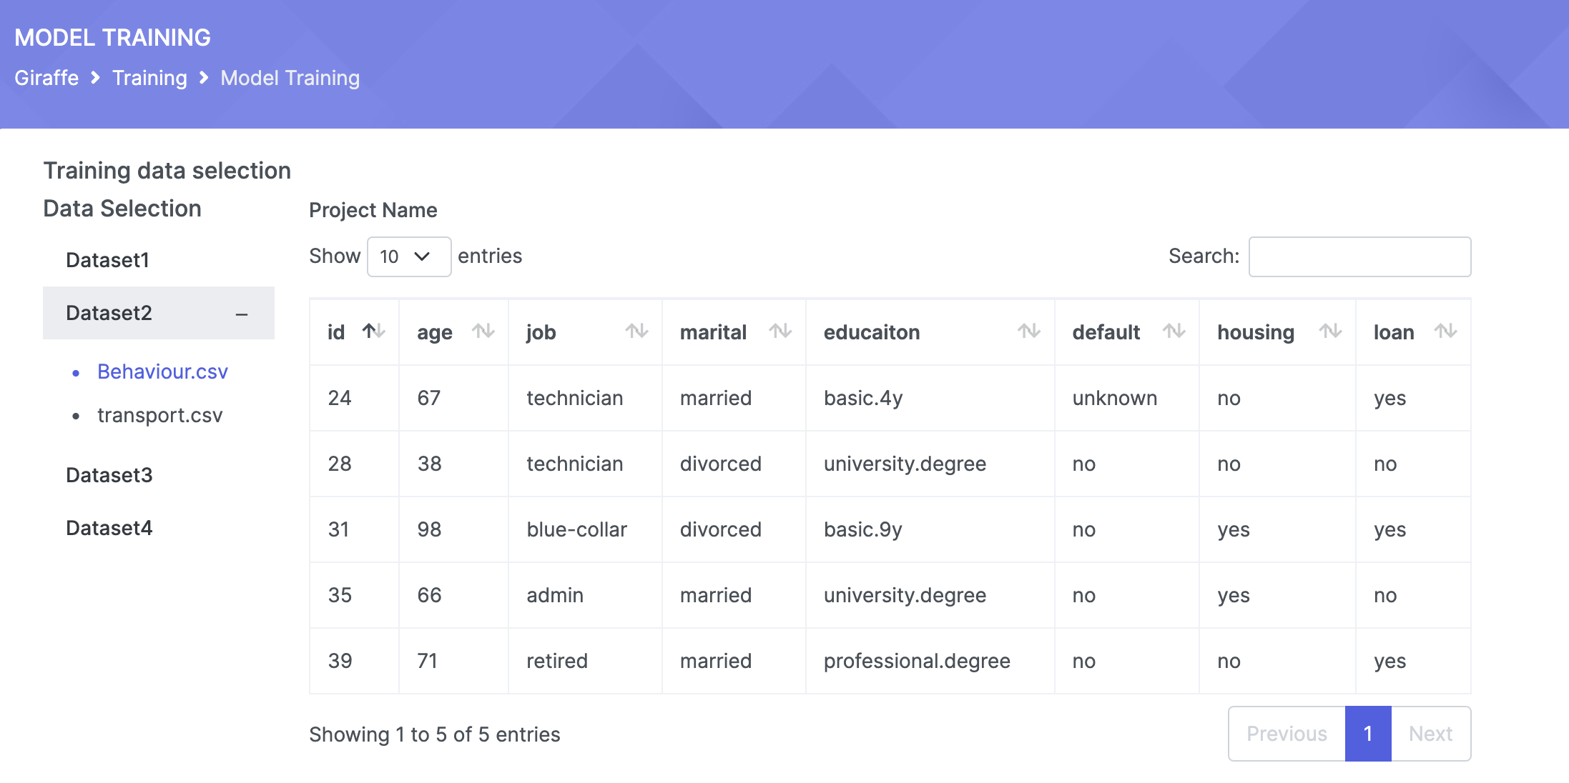
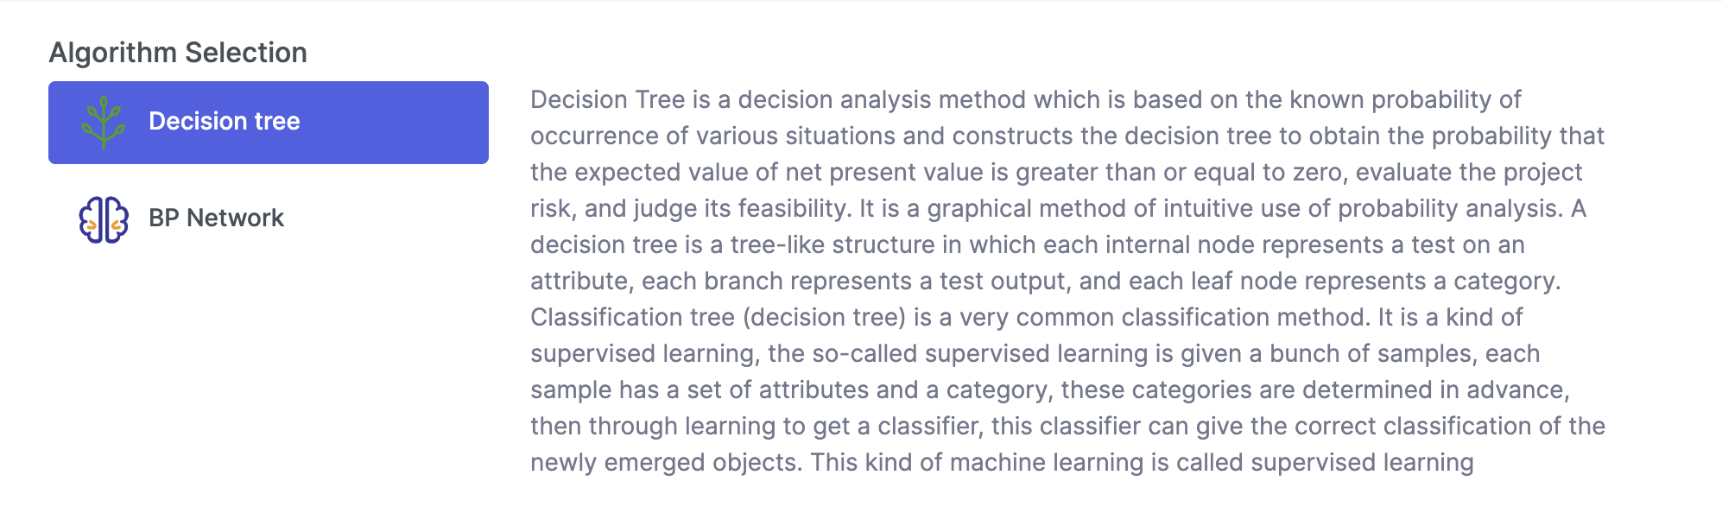
Model engineers’ view
Convenient and flexible
user interface
Different machine learning algorithms
Visualisation of training process (e.g., decision tree)
Concise graphical model interpretation
Etc…

Slide 9

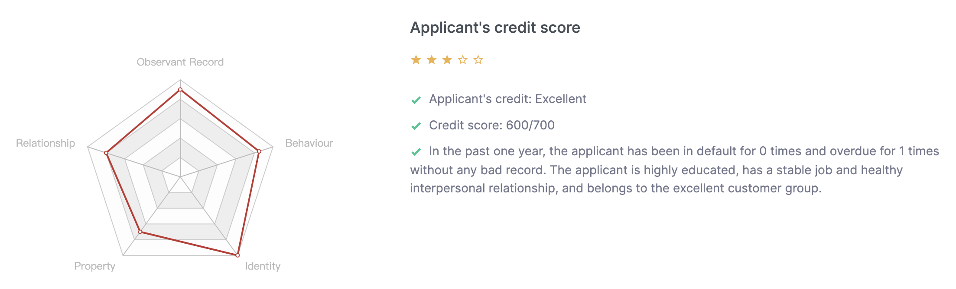
Loan managers’ view
Clear prediction result and credit score assessment
Interpretable to applicants
Suggest model modifications to engineers if necessary

Slide 10



Additional functions
Email
Chat
Calendar

Slide 11
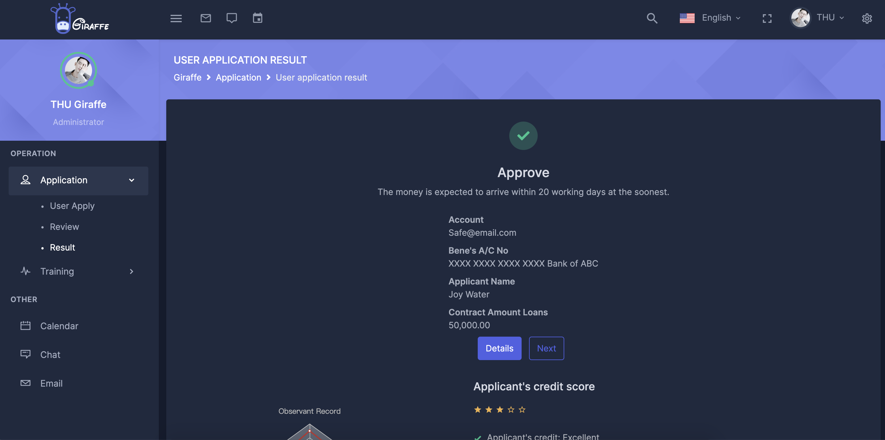
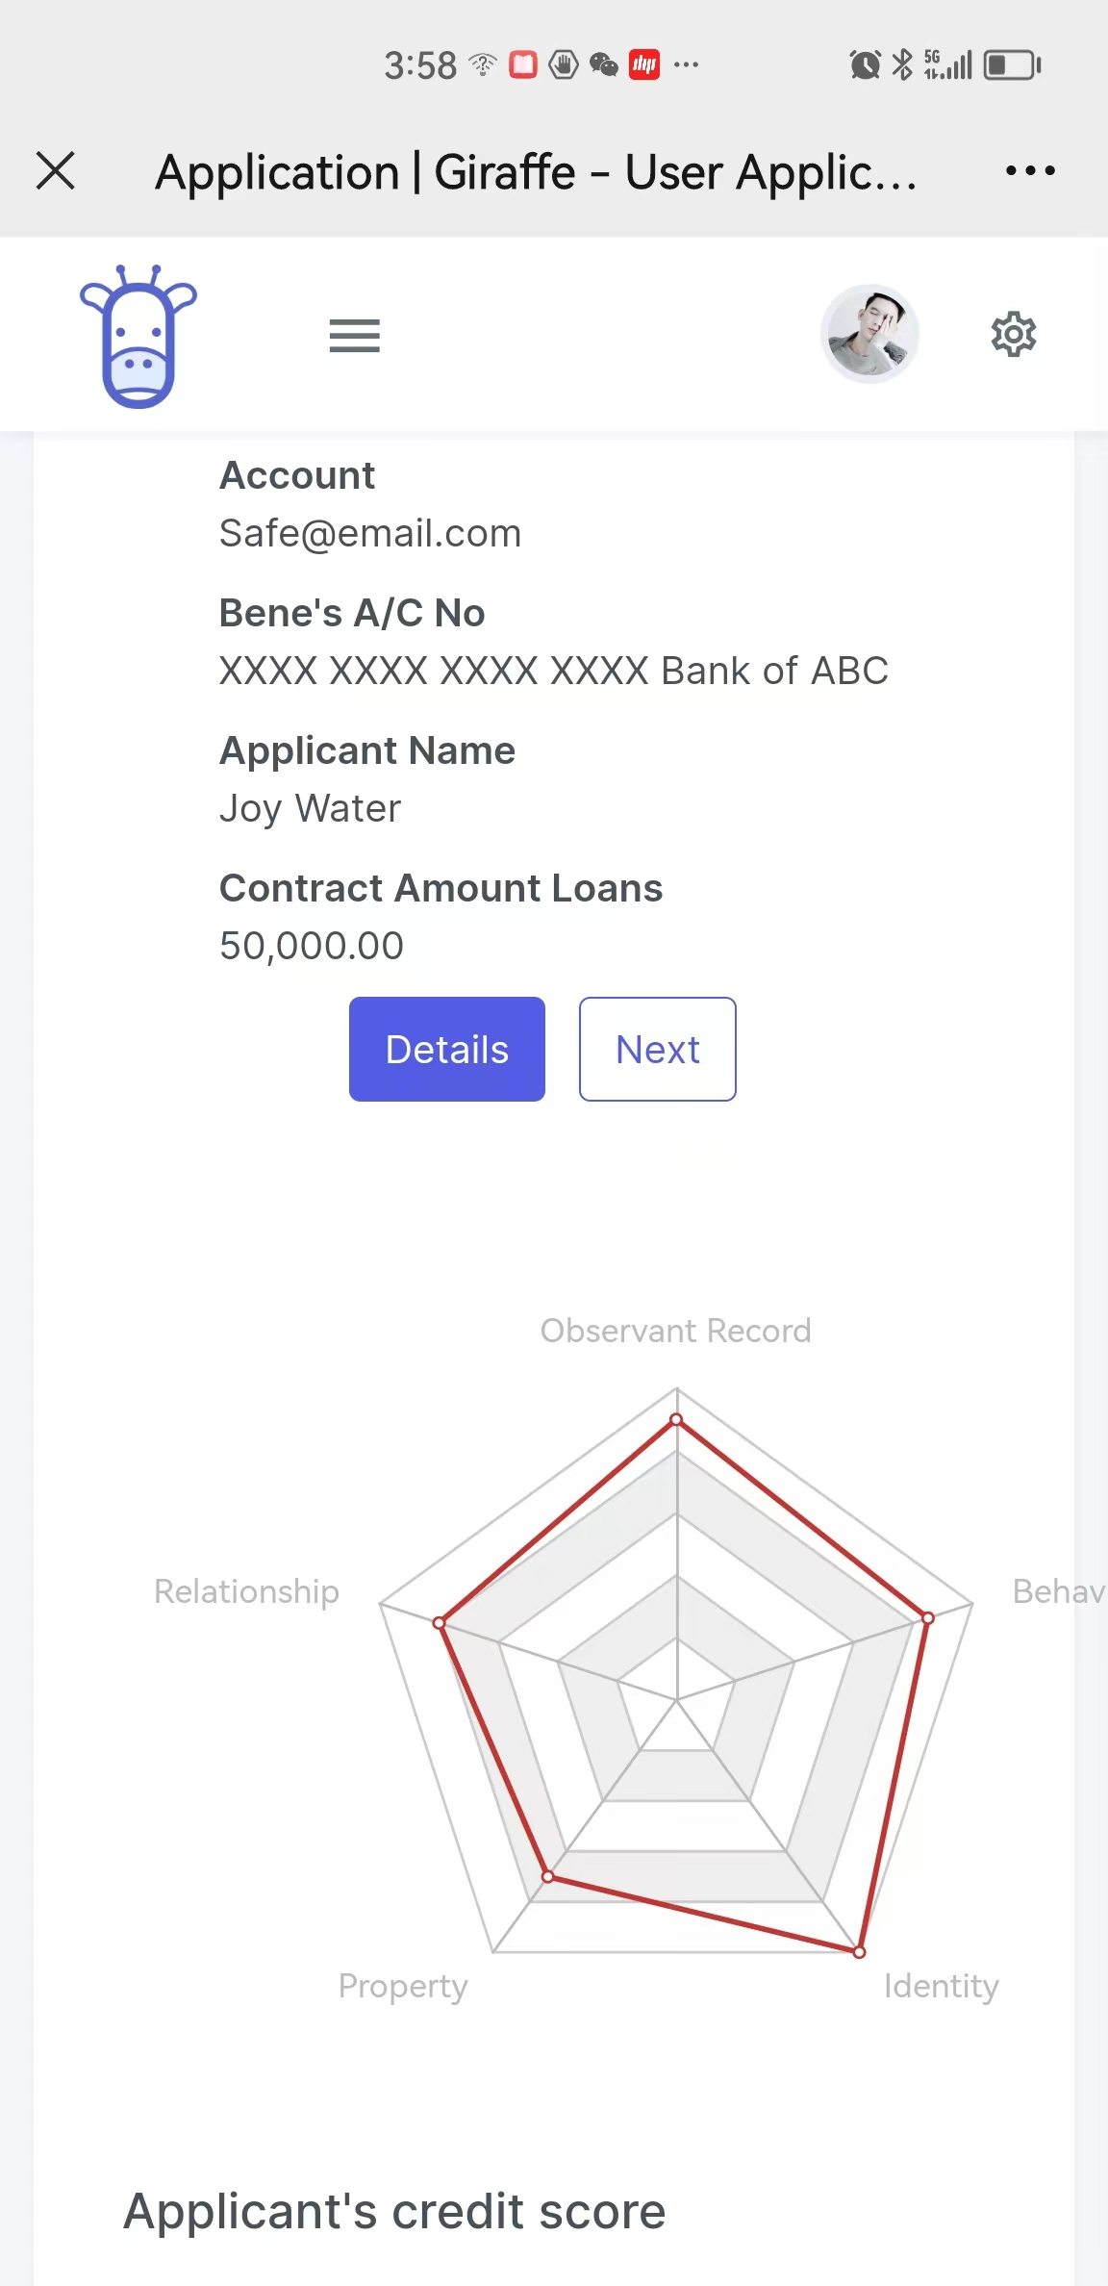
One more thing
—— Dark Mode
—— Compatible for different devices
PC, Mobile, Tablet

Slide 12
System Architecture
Data analysis terminal
Modeling terminal
Result Report
Privacy-preserving
Feature Engineering
Model train & Analysis
Risk monitoring
Generate anonymous features
Model selection
Feature correlation analysis
Data reports/graphs
Model ensemble
Data Insights
Feature importance analysis
Model training
Statistical
characterisation analysis
Data visualization
User Registration
Structure display
Feature stability analysis
Data Pre-process
User Credit Report
Historical model retrospect
External Data
Data cleaning and outliers handling
Feature derivation
Mail/IM
Model testing
Missing value imputation
Invalid feature filtering
Interpretation of results
PC end
Data normalisation
Visualisation analysis
Tablet
Smart Phone

Slide 13
Feature processing
Variable filtering
Feature IV (Information Value)
Feature Correlation
Higher IV
Easier to judge default
More suitable for modeling
Excessive feature correlation leads to the problem of multicollinearity in multiple regression models
IV
Corr
IV value should be greater than 0.02
Feature correlation gap greater than 0.15
Feature PSI (Population Stability Index)
Feature Adversarial Validation
Lower PSI
The smaller the gap between the actual and expected distribution of variables
The more stable the distribution of variables
Near 0.5 means that the features are equally distributed in the training and test sets
PSI
IID
PSI value should be lower than 0.2
Single feature AUC less than 0.7

Slide 14
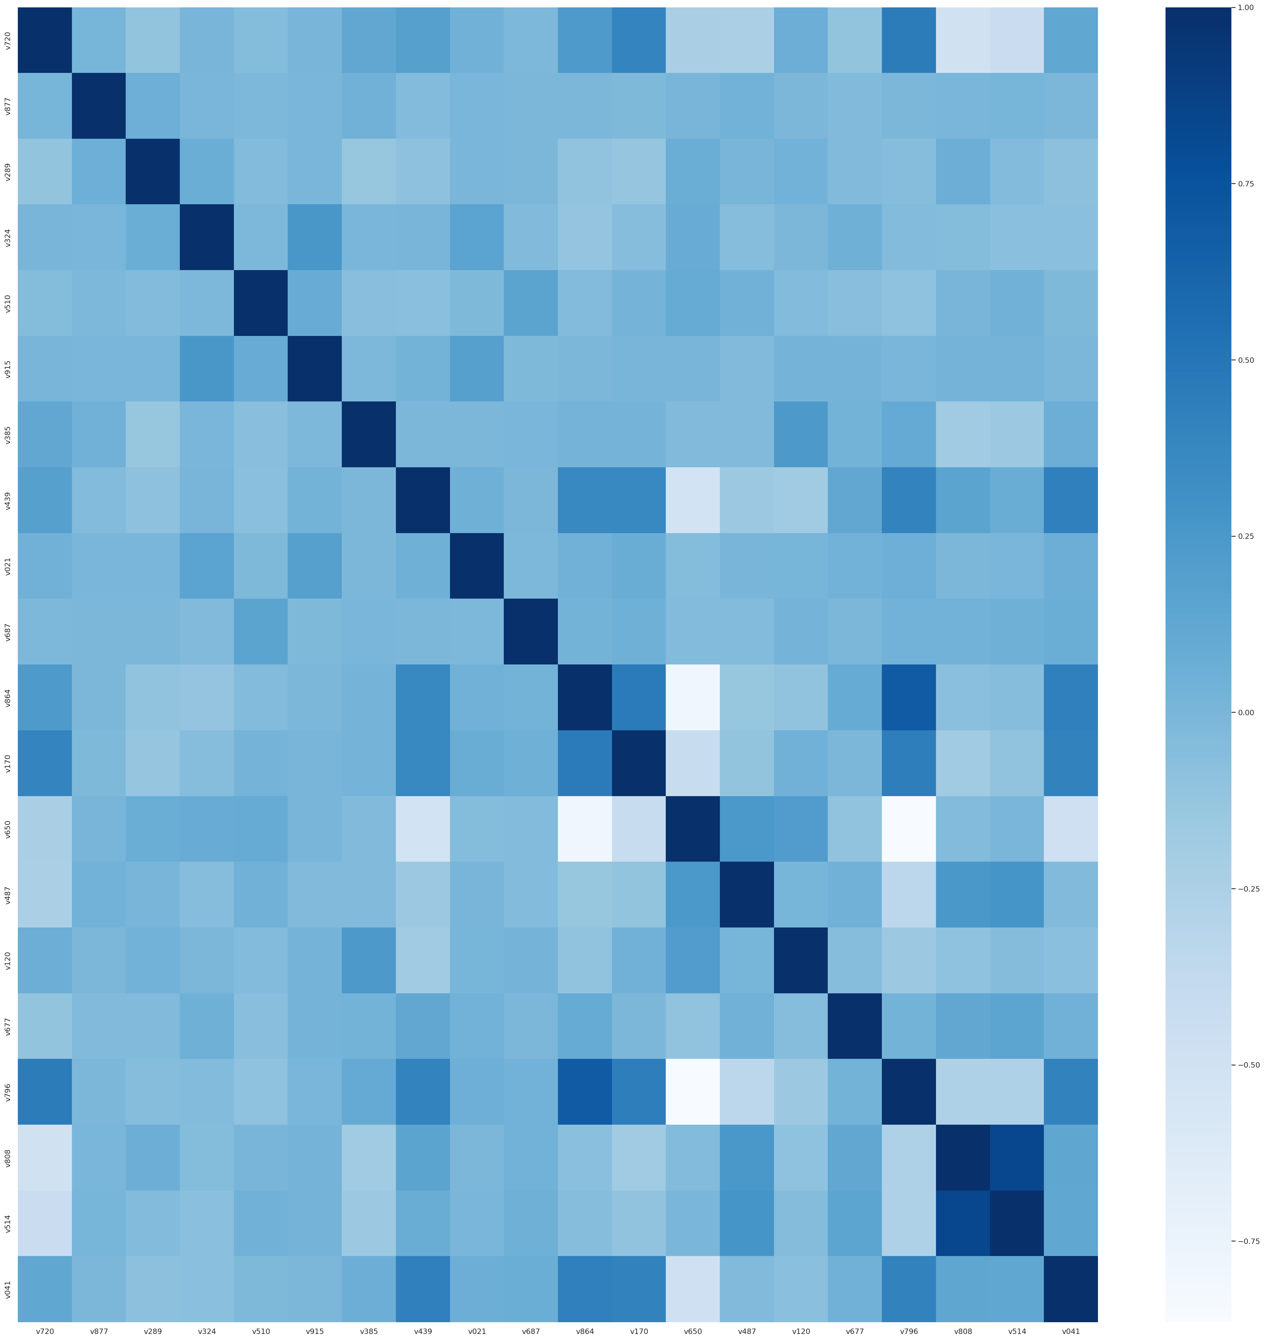
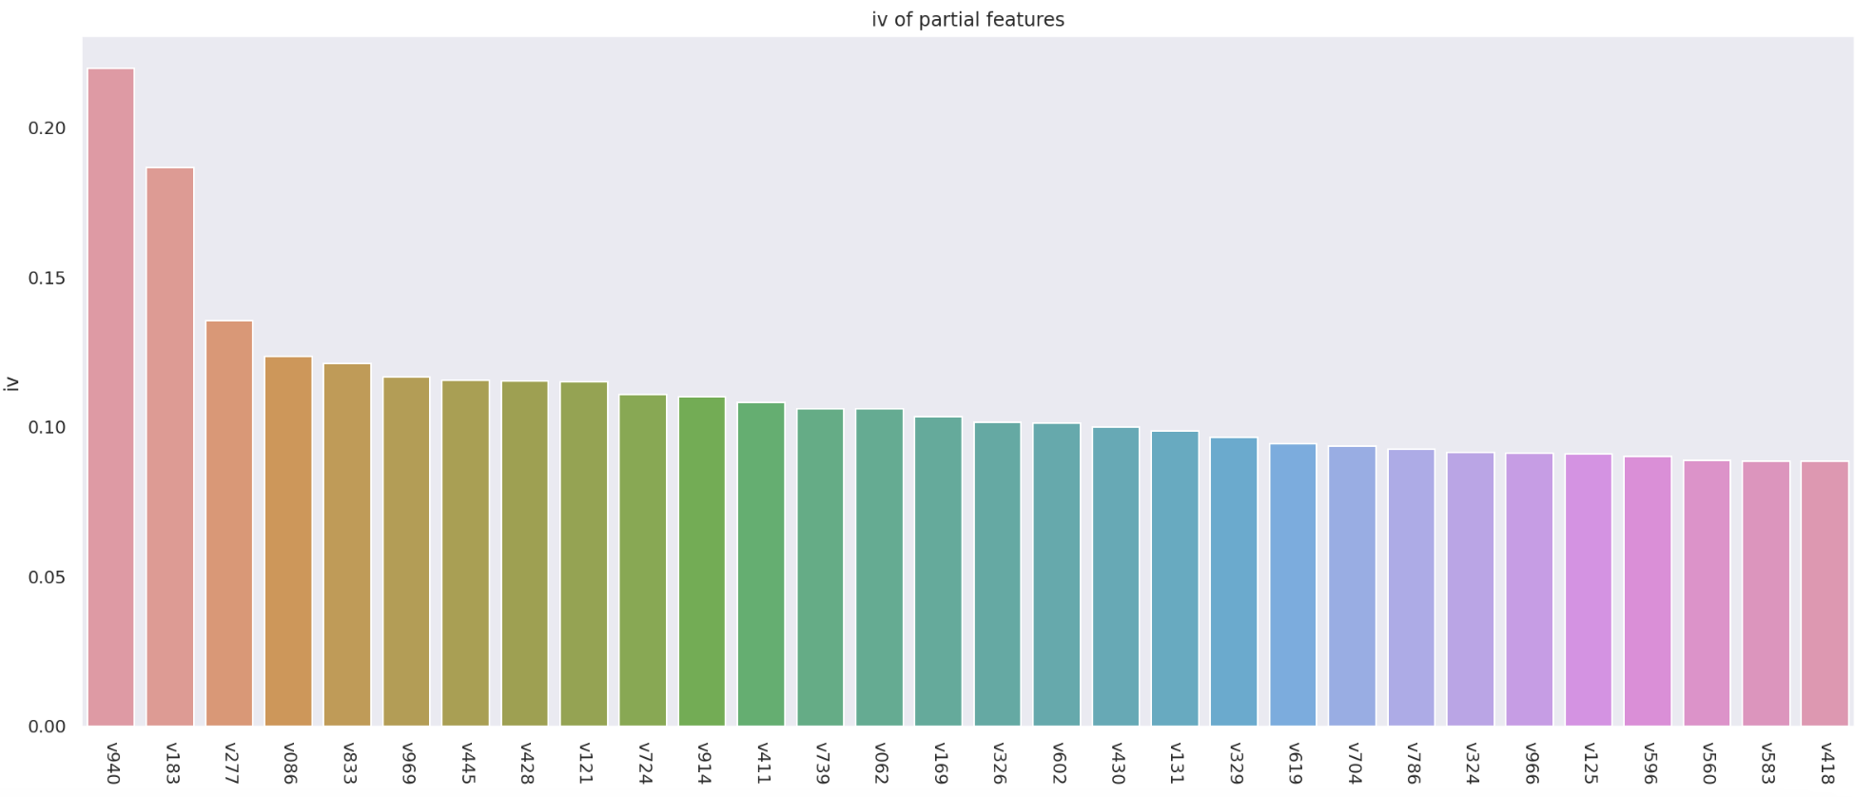
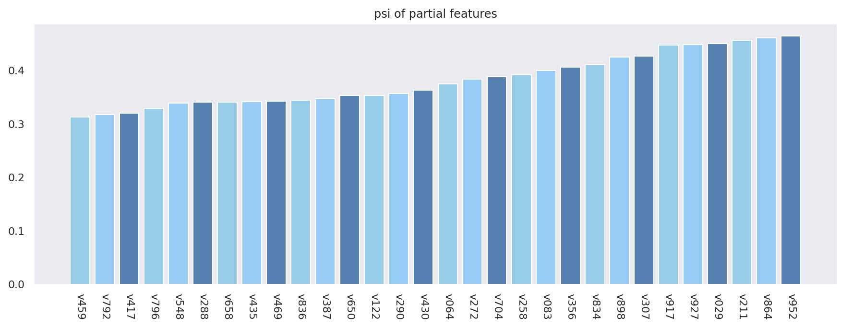
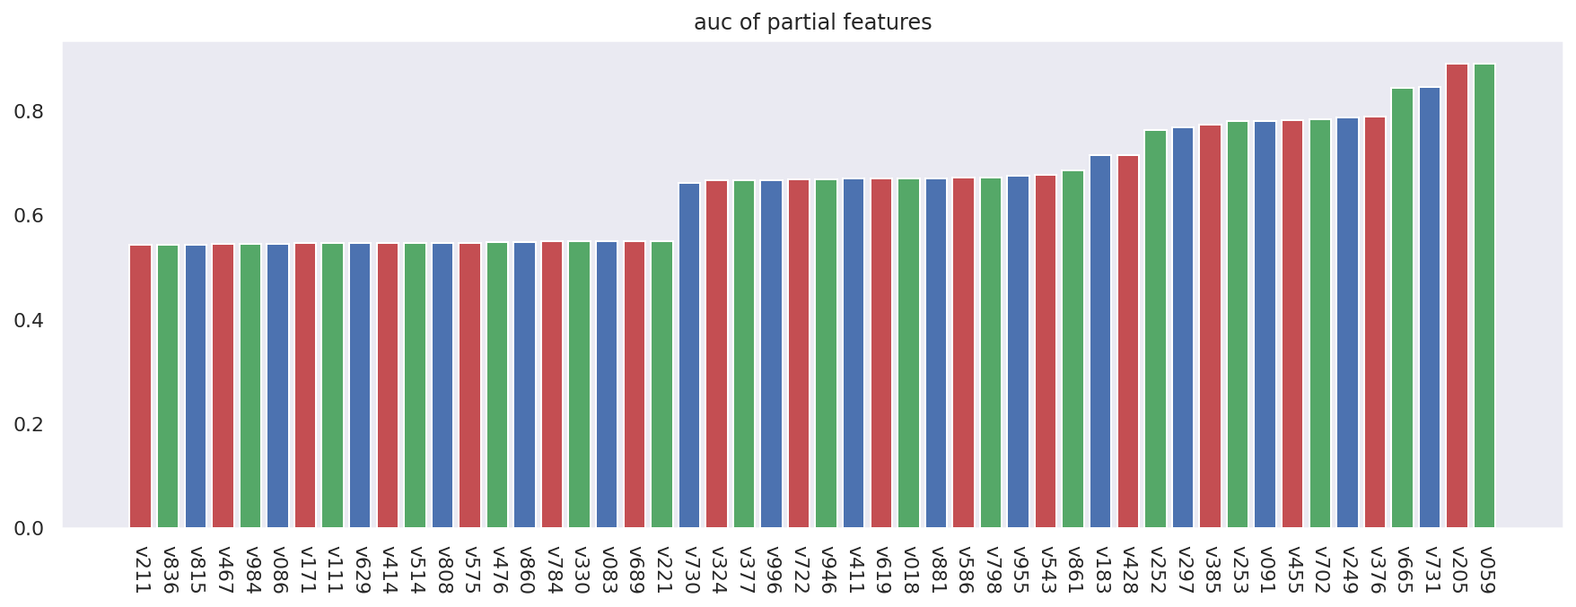
Feature processing
Feature Filtering
Independence
IV(Information Value)
Importance
v808
v514
> 0.02
< 0.15
Correlation
PSI(Population Stability Index)
AUC of Single Feature
< 0.2
< 0.7
Effectiveness
Stability

Slide 15
Model overview
Feature Engineering
Feature 1
Feature 2
…
Feature n
Train dataset
Validationdataset
Base Model
XGBoost
LightGBM
CATBoost
Fusion Model
Using Logistic Regression to integrate model prediction results
Test dataset
Feature or Attribute (Internal node)
Submit Result
Label (Leaf node)

Slide 16
Modelling methods
5-Fold Cross-Validation
Grid Search
Fold 1
Fold 2
Fold 3
Fold 4
Fold 5
Set parameter range
Adjust the parameter step by step
Train the base model
Get the better parameter
Test
Train
Train
Train
Train
Round 1
Round 2
Train
Train
Test
Train
Train
Round 3
Train
Train
Train
Test
Train
Round 4
Train
Train
Train
Test
Train
Train
Train
Train
Train
Test
Round 5
Fayed, H. A., & Atiya, A. F. (2019). Speed up grid-search for parameter selection of support vector machines. Applied Soft Computing, 80, 202-210.

Slide 17
Model training
Training Results
 | Train-AUC | Validation-AUC | Test-AUC
XGBoost | 0.6435 | 0.6424 | 0.6337
XGBoost* | 0.7054 | 0.7059 | 0.7027
LightGBM | 0.6427 | 0.6436 | 0.6361
LightGBM* | 0.7057 | 0.7061 | 0.7032
CATboost | 0.6421 | 0.6410 | 0.6344
CATboost* | 0.7049 | 0.7050 | 0.7020
Ensemble Model | 0.7066 | 0.7067 | 0.7043
* Indicates improvement of model when selected features are eliminated.
Feature Filtering is effective

Slide 18
Highlights of Giraffe
Model visualisation
Decision explainable
Model suggestion
Privacy preserving
Efficient
Effective
Explainable
Generalisable

Slide 19
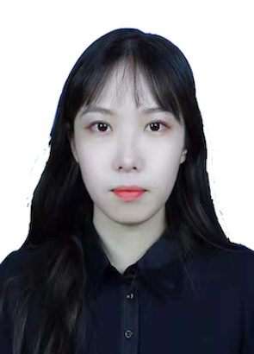





Meet team
DaWei
Product design, product management
YaQi
Product design and presentation
JunXiang
Data analysis, modelling
XinRan
Data analysis, modelling
Wanyi
Server development and operation
SiYu
Server development and operation

